Slide 1
Intro to Data with Python
Kang Sun
Yiming Tan
Haoyu Zhang
Xiaoxi Zhao

Slide 2

Installing
Anaconda
https://docs.anaconda.com/anaconda/install/
Python 2 or Python3?
Anaconda helps you manage them!

Slide 3
How can we get data?
Search open datasets
http://library.columbia.edu
> Location > Business & Economics Library > Business Databases
> Services > Digital Data Services > Research Guides / GeoData@Columbia /…
Collect by ourselves
Web scraping (upcoming data club events!)
Go to (Wei’s) Consultation Hours!!!
https://library.columbia.edu/services/research-data-services/schedule.html
Today’s Dataset
https://github.com/columbia-university-libraries-data-club/intro-to-data

Slide 4
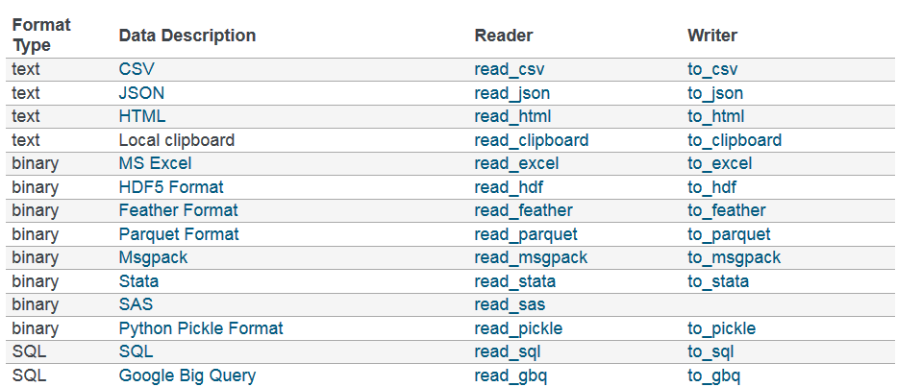
Data formats and methods to import
Open and read a file in python
file_object = open(“filename”, “mode”)
file_object.read, file_object.readline(), file_object.readlines()
Use IO tools in pandas
For more information:
https://pandas.pydata.org/pandas-docs/stable/user_guide/io.html

Slide 5
Data types
Why do we need data types?
We have different kinds of data and we do not use the same format to describe all data we see. That’s why we need different data types.
Data types add constraint on data and make them easy to manage.
Different data types: numeric, logical, character, string, …

Slide 6
Numeric data
Integers and Floating-Point Numbers
The range of integers is not just positive numbers, negative numbers are also integers, like -14131313133133131879 and -1.
Floating-Point Numbers are specified with a decimal point.

Slide 7
Data types of Python --- numeric
Integers (int)
In Python 3, there is effectively no limit to how long an integer value can be. Of course, it is constrained by the amount of memory your system has.
>>> X = 1113123123123124124124124123414
>>> print(X)
Floating-Point Numbers (float)
>>> type(4.2)
<class ‘float’>
>>> type(4.0)
<class ‘float’>
>>> .4e7
4000000.0

Slide 8
Data types of Python --- numeric
With numeric data types, we can perform operations on them.
> K = 3
> B = 2.0
> C = K+B
> print(C)
5.0
> print(type(C))
<type ‘float’>
> K = 3.7
> B = 2.0
> C = K*B
> print(C)
7.4
> print(type(C))
<type ‘float’>
One thing is notice is division between integers
Like 9/2

Slide 9
Logical data
Logical data just has two values, True and False.
It can not store much information, but we can use it to store status of our program.
The same purpose can also be achieved by using integer values 0,1. But such design is not safe since the integer type can have other many values and there is potential risk that the value is changed.
Logical data only does the task it is assigned! And this is why we need it.

Slide 10
Logical data in Python
Logical type is also called Boolean type in Python.
Two values, ‘True’ and ‘False’. Not ‘TRUE’ or ‘true’ !
We can change between True and False
> X=not True
> print(X)
> print(type(X))
> C = not X
> print(C)
Compare two Boolean data
> X = True
> B = True / B = False
> print(X == B)

Slide 11
Logical data in Python
Comparison operators
> x=2
> 1< x <3
> 10 < x < 20
> x == 3
> x != 2
AND /OR
X and Y = True only when X,Y are True
X or Y = False only when X,Y are False
X and Y can also written as X & Y
X or Y can also written as X or Y
The comparison operators are very important to decide whether we have met the goal.
Assume we want to have run 10 miles, and we use X to store how many miles we have finished.
When X >= 10, stop.

Slide 12
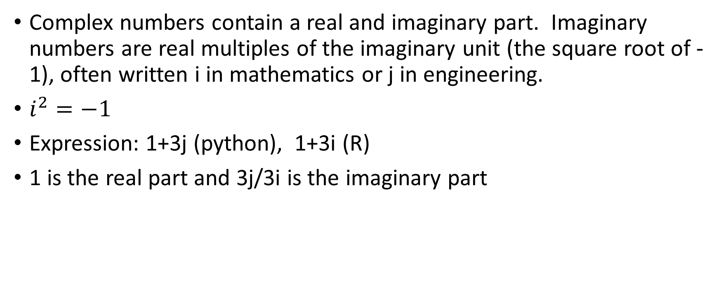
Complex type
Complex numbers contain a real and imaginary part. Imaginary numbers are real multiples of the imaginary unit (the square root of -1), often written i in mathematics or j in engineering.
$i^{2}=−1$
Expression: 1+3j (python), 1+3i (R)
1 is the real part and 3j/3i is the imaginary part

Slide 13
Complex type in Python
P ‘j’ or ‘J’ after a number to make it the imaginary part.
> 1j
> 1J
> 1j * 1j
The result is (-1 + 0j)
> (1+2j) * (1+2j)
The result is (-3+4j)
> complex(1,3)
It generates (2+3j)
> X = 1+3j
> print(x.real)
1.0
> print(x.imag)
3.0
> print(z.conjuagete())
(2-3j)

Slide 14
Character types
Character types represent string values.
String values is different from previous types. In string values, we can include numeric numbers, letters, or special characters like ‘+’, ‘:’,… anything you can get from a keyboard.
Example character types
“aabbcc’aabbcc’_”
“1234 “
Please notice that there are spaces after ‘4’ on above string values.

Slide 15
String in Python
String in Python is shown using double quotes or single quotes.
> print(‘hello world’)
> print(“hello world”)
Anything between double quotes and a single quote is a string.
> “ *&(&(*)*) 1 ”
Question:
> A = “PYTHON OPEN LAB’”
What is A?
Brackets much match!

Slide 16
String in Python
Concatenation
> S1 = “Hello”
> S2 = “World”
> S3 = S1+S2
Index
> A = “12345”
A[0] ? A[1] ? A[2]? A[3] ? A[4] ? A[5]?
Slice
> A = “1234567”
A[2:5] ? A[2:] ? A[2:-1]?

Slide 17
Data frame
Data frame as a way to store data in rectangular grids that can easily be overviewed.
Each row of these grids corresponds to measurements or values of an instance, while each column is a vector containing data for a specific variable. This means that a data frame’s rows do not need to contain, but can contain, the same type of values: they can be numeric, character, logical, etc.

Slide 18
Data Frame in Python
In general, you could say that the Pandas DataFrame consists of three main components: the data, the index, and the columns.
Firstly, the DataFrame can contain data that is:
a Pandas DataFrame
a Pandas Series: a one-dimensional labeled array capable of holding any data type with axis labels or index. An example of a Series object is one column from a DataFrame.
a NumPy ndarray, which can be a record or structured
a two-dimensional ndarray
dictionaries of one-dimensional ndarray’s, lists, dictionaries or Series.

Slide 19
Code Examples

Slide 20
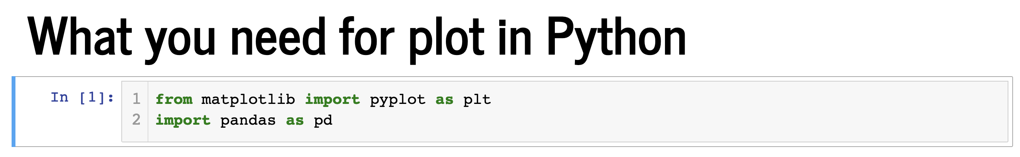
Plot in Python

Slide 21
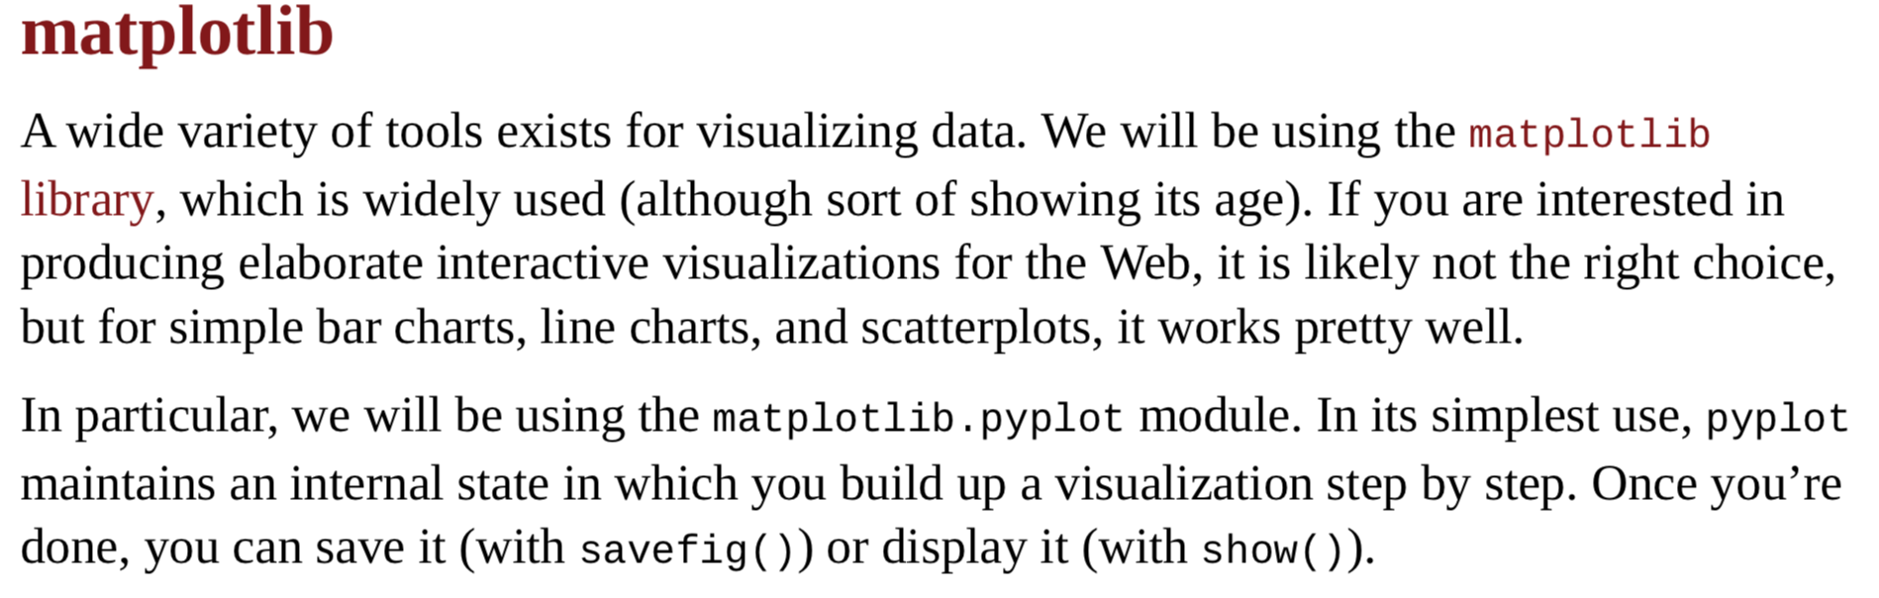

Slide 22
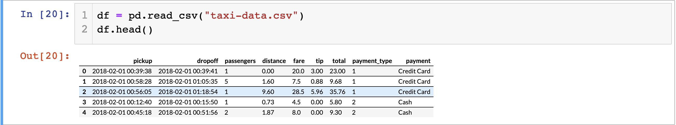

Slide 23
1.Bar plots and Histogram in Python
Using bar chart is a good choice when you want to show how a certain quantity varies among discrete set of items.
Histograms are frequently used to show brief information about the distribution of a (discrete or continuous) variable.

Slide 24
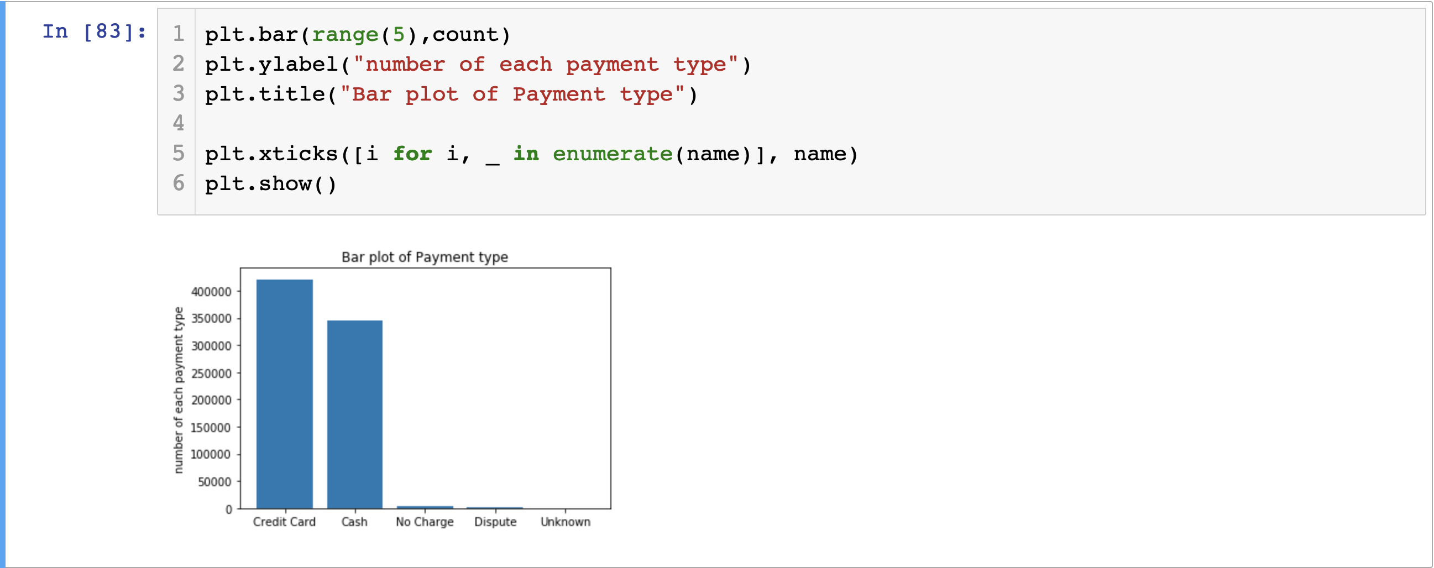

Slide 25
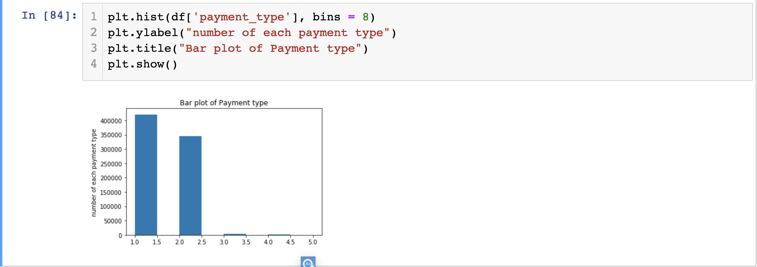

Slide 26
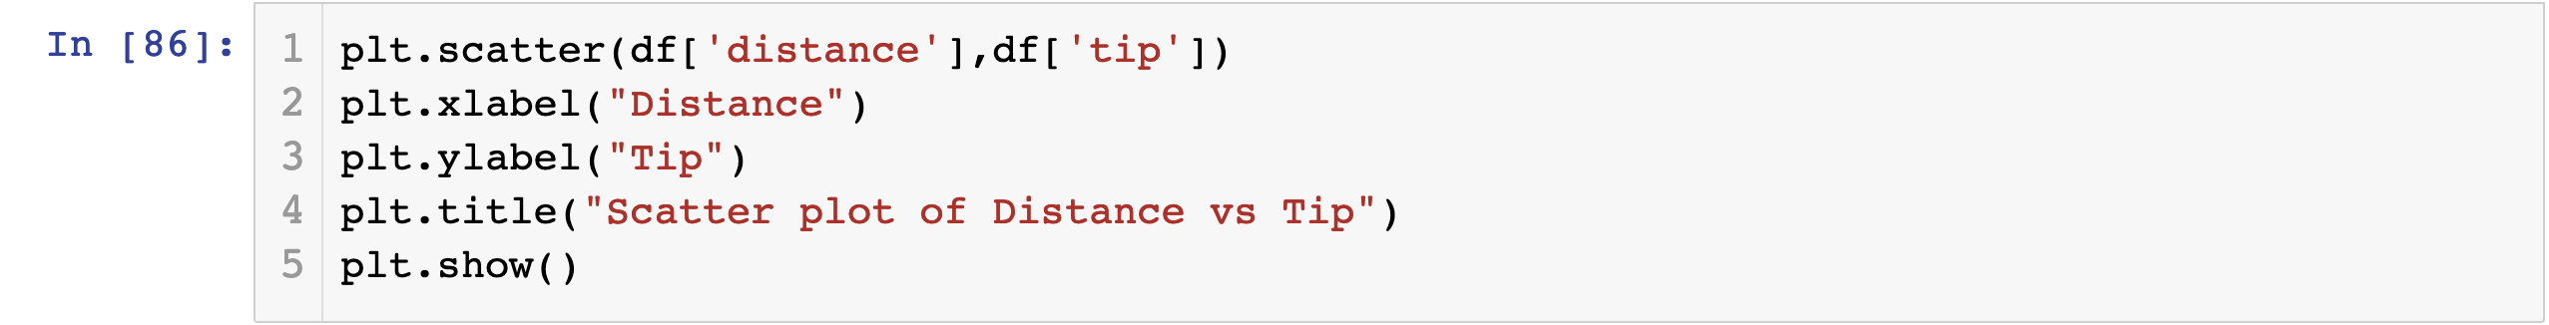
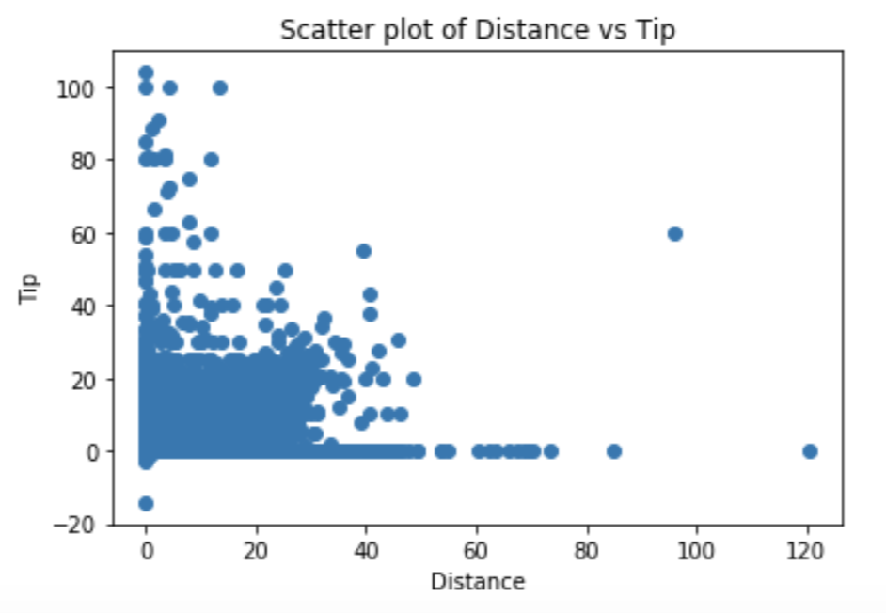
2.Scatter Plot in Python

Slide 27
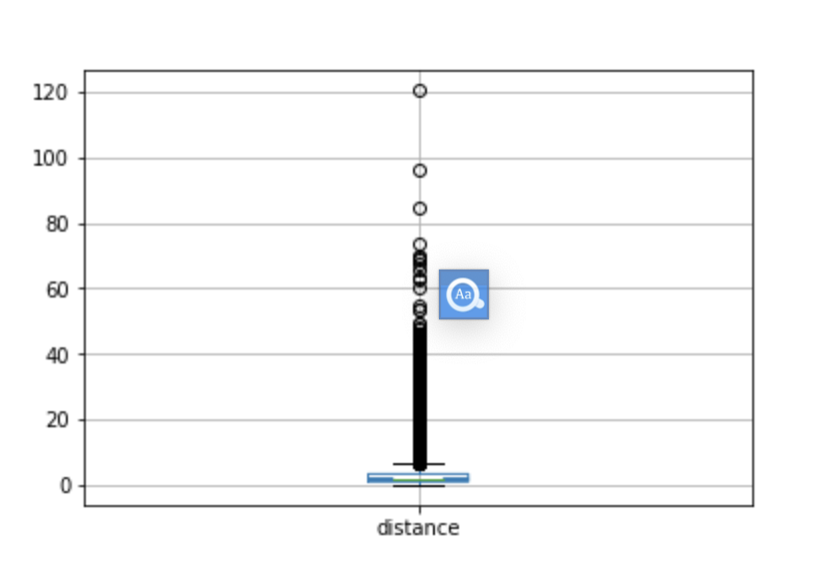
3. Box Plot in Python

Slide 28
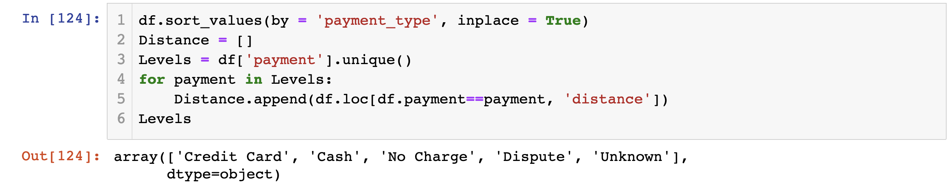
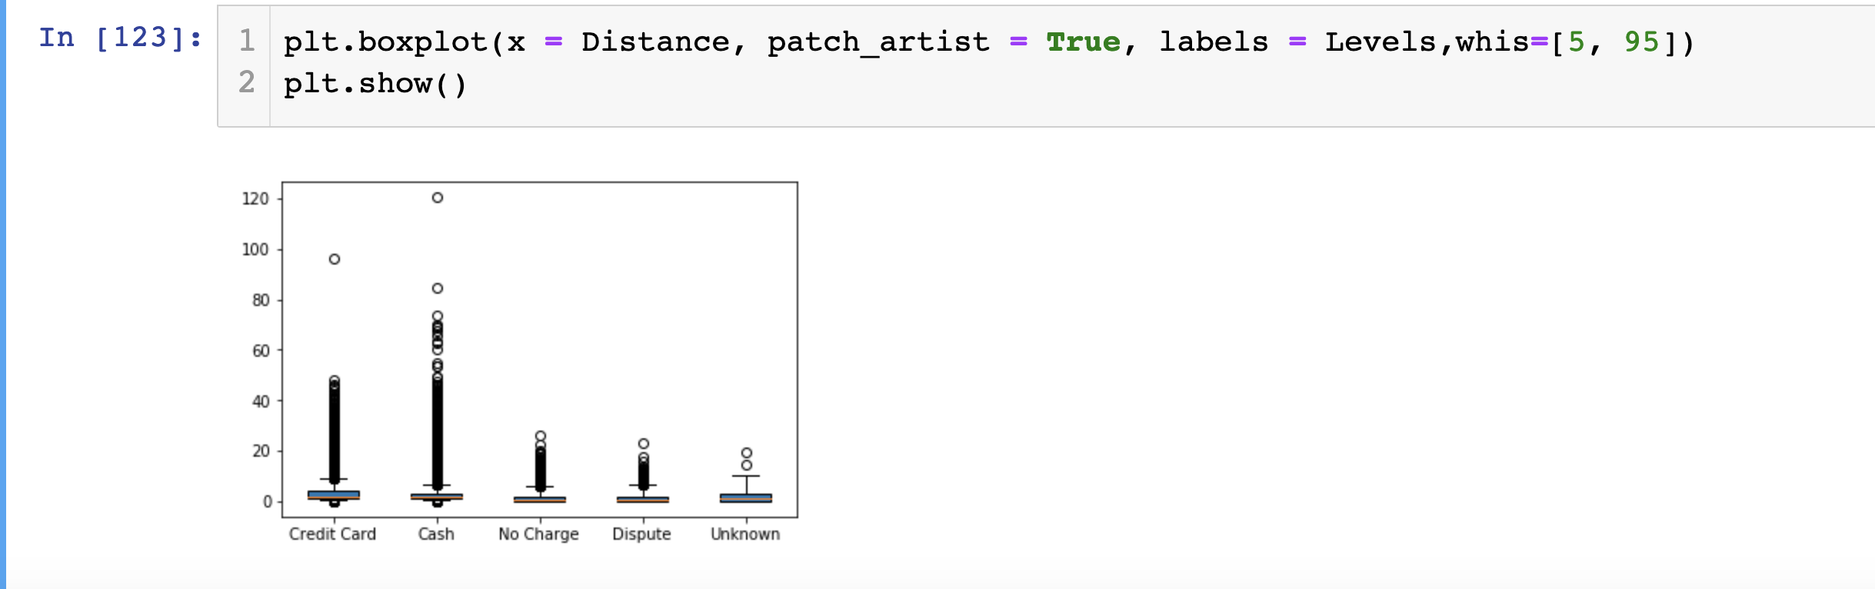
v

